Slide 1
Inroduction Of GlusterFS
Meng Yang
meyang@redhat.com
2016.5

Slide 2
Agenda
Introduction
GlusterFS Concepts
Volume types
Access gluster volume
demo

Slide 3

Introduction
Volume Types

Slide 4
History
GlusterFS project started as the part of Gluster Project (http://www.gluster.org/) around July 2005.
Build in userspace for speed, flexibility, and ease of use
Eliminate a centralized metadata server for performance and reliability
Make the product modular to simplify configuration and minimize dependencies
Make use of the underlying disk file system and don’t reinvent the wheel
Store data as standard files and don’t use proprietary formats
GlusterFS 1.2.3 stable release came around Feb 2007 , Version 2 of the product was released in May of 2009
The name Gluster combined GNU and cluster
In 2011, redhat bought it using 138 million dollar
Redhat gluster storage published

Slide 5
Introduction
Distributed file system capable of scaling to several petabytes
Handling thousands of clients.
Built on Commodity systems
No Metadata Server
Userspace filesystem

Slide 6
Concepts
Brick
Volume
Peer / Node
  Server hosting the brick filesystems
  Runs the gluster daemons and participates in volumes
Translator
  Logic between the file bits and the Global Namespace
  Layered to provide GlusterFS functionality
Trusted storage pool
  Trusted Storage Pool (cluster) is a collection of storage
  servers

Slide 7
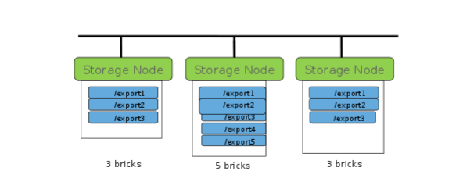
bricks
  the basic unit of storage in GlusterFS
  represented by an export directory on a server in the trusted storage pool:
  myhostname:/exports/myexportdir/
  Each brick inherits limits of the underlying filesystem

Slide 8
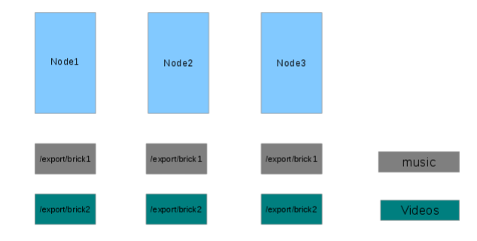
Volumes
  A volume is a logical collection of bricks
  Ultimately, what's presented to the end user
  One or more volumes can be created on the same node

Slide 9
Concepts
glusterd
  Management daemon
  One instance on each GlusterFS server
  Interfaced through gluster CLI
glusterfsd
  GlusterFS brick daemon
  One process for each brick on each server
  Managed by glusterd
glusterfs
  Client end cmd
  [root@ibm-x3650m4-05 gluster]# ps aux | grep gluster
  root 17001 0.3 0.0 552820 30172 ? Ssl 11:22 0:00 /usr/sbin/glusterfs --volfile-server=gluster-virt-qe-01.lab.eng.pek2.redhat.com --volfile-id=distdata01 /gluster
mount.glusterfs
  FUSE native client mount extensions

Slide 10
Volume Types
Volume Types

Slide 11
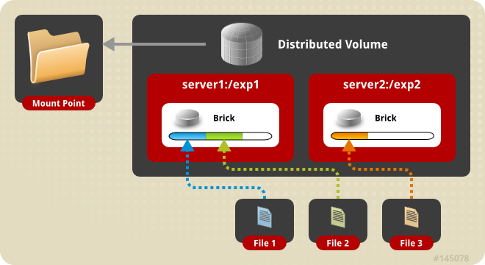
Distributed Volume
The default configuration
Files “evenly” spread across bricks
Similar to file-level RAID 0
Server/Disk failure could be catastrophic
Notes:
利用搭好的distribute volume 去创建一些文件,去看看随机分布性,例如,去我挂载好的目录去 touch {1..20}.txt
然后分别去我的两个node查看创建的文件时不时随机的

Slide 12
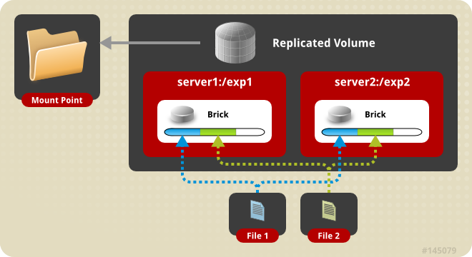
Replicate Volume
Files written synchronously to replica peers
Files read synchronously, but ultimately serviced by the first responder
Similar to file-level RAID 1

Slide 13
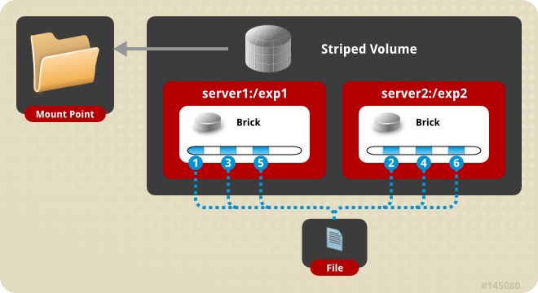
Striped Volume
Individual files split among bricks (sparse files)
Similar to block-level RAID 0
Limited Use Cases
  Load balance
  File size exceeds brick size

Slide 14
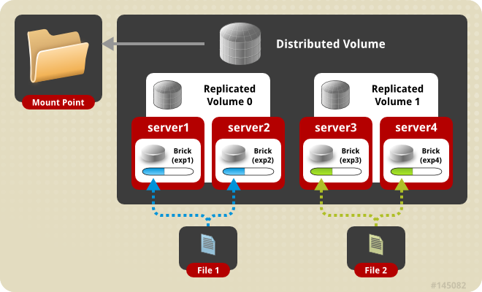
Distributed Replicated Volume
Distributes files across multiple replica sets

Slide 15
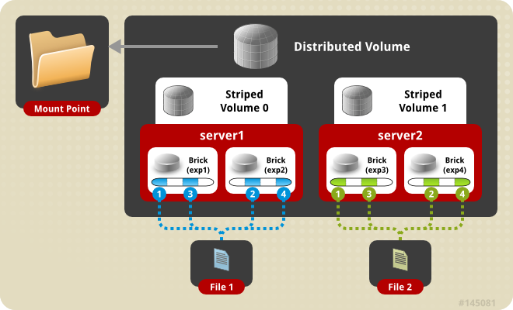
Distributed Striped Volume
Distributes files across multiple stripe sets
Striping plus scalability

Slide 16
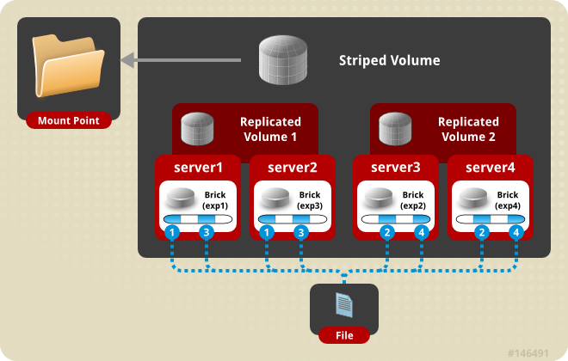
Striped Replicated Volume
Replicated sets of stripe sets
Similar to RAID 10 (1+0)

Slide 17
How Gluster Works
Volume Types

Slide 18
Work flows
Install Gluster Server
1. mount gluster filesystem
2.client glusterfs process communicate with glusterd deamon in server
3.glusterd will send the vols files to client(vols files contains the list of translaters and contains the configs of the brick in the volume)
4.according to the configs in step3,the client glusterfs process can now communicate with the bricks glusterfsd
Start Glusterd
Create Volume using
bricks
Glusterfsd will be
Started for each brick
Vols file will be generated too.

Slide 19
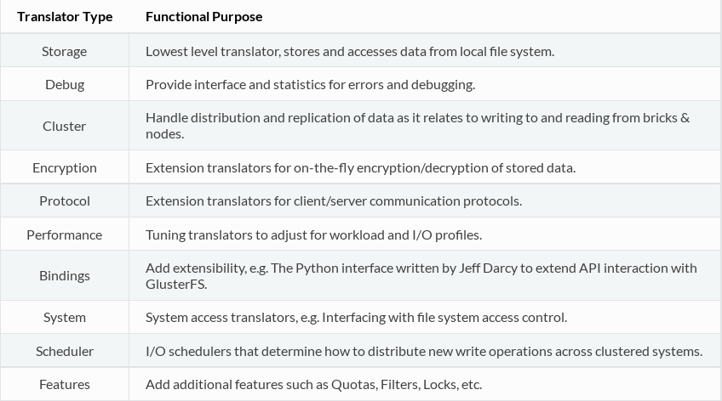

Slide 20
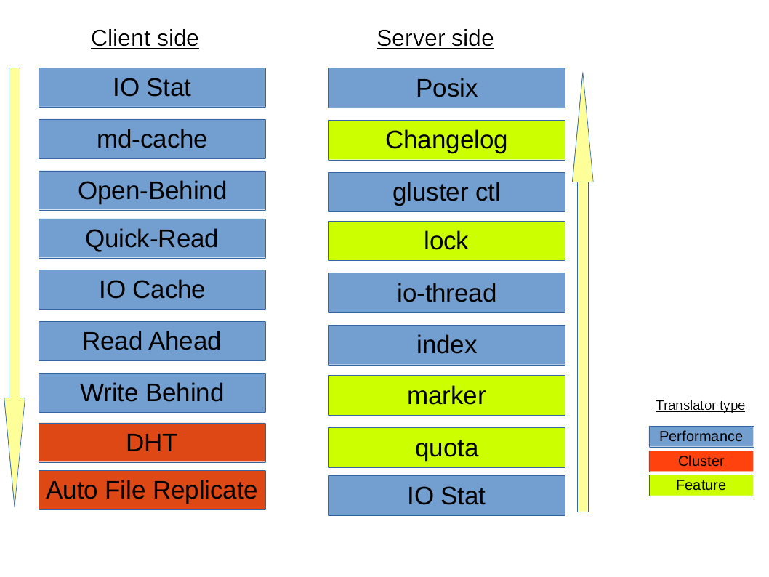
Notes:
Handle distribution and replication of data as it relates to writing to and reading from bricks & nodes.
Performance: Tuning translators to adjust for workload and I/O profiles.

Slide 21
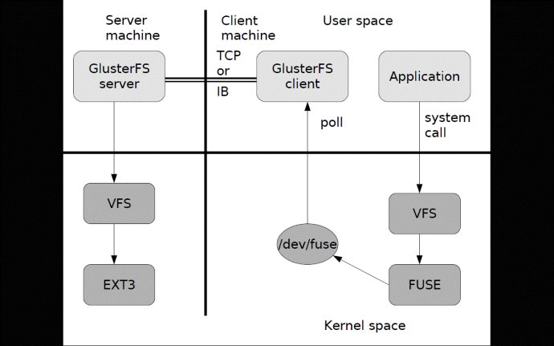
Glusterfs client consists of translators ,those translators are defined according to the vols files
FUSE translator
DHT translator- DHT translator maps the request to the correct brick that contains the file or directory required.
AFR translator- It receives the request from the previous translator and if the volume type is replicate, it duplicates the request and pass it on to the Protocol client translators of the replicas.
Protocol Client translator- Protocol Client translator is the last in the client translator stack. This translator is divided into multiple threads, one for each brick in the volume. This will directly communicate with the glusterfsd of each brick.

Slide 22
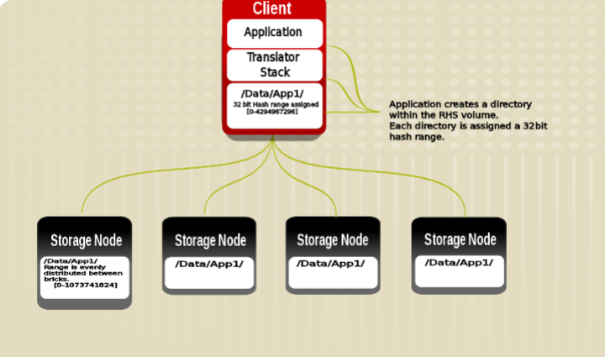
Uses Davies-Meyer hash algorithm.
A 32-bit hash space is divided into N ranges for N bricks
At the time of directory creation, a range is assigned to each directory.
During a file creation or retrieval, hash is computed on the file name. This hash value is used to locate or place the file

Slide 23
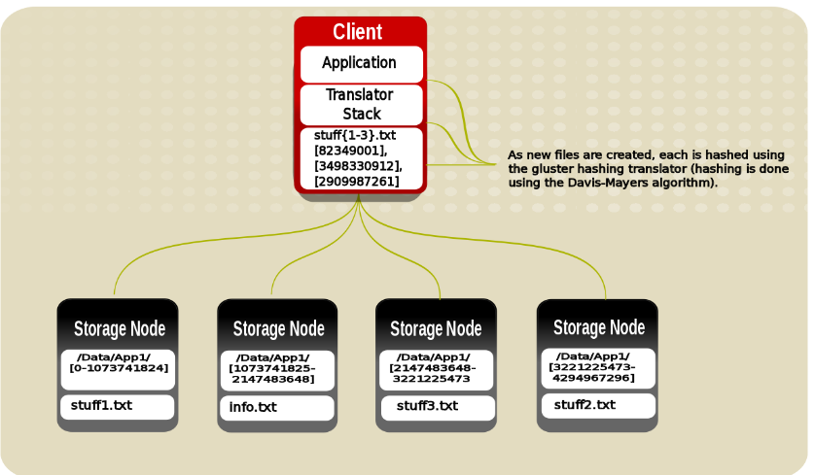

Slide 24
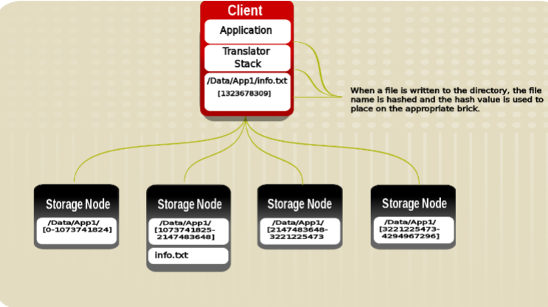

Slide 25
Access gluster volume
Volume Types

Slide 26
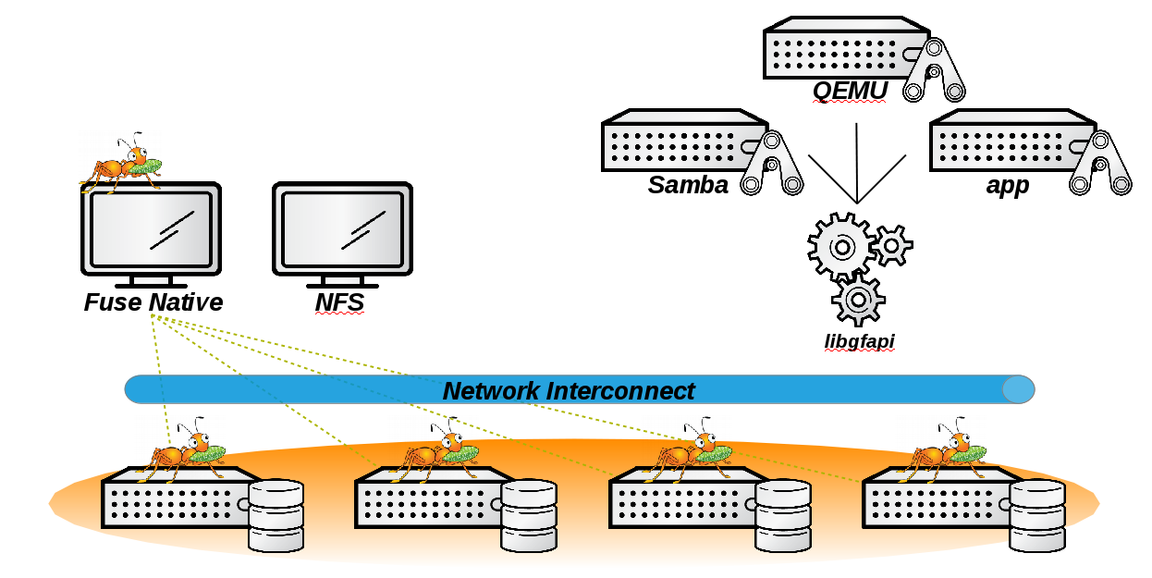
Access gluster volume

Slide 27
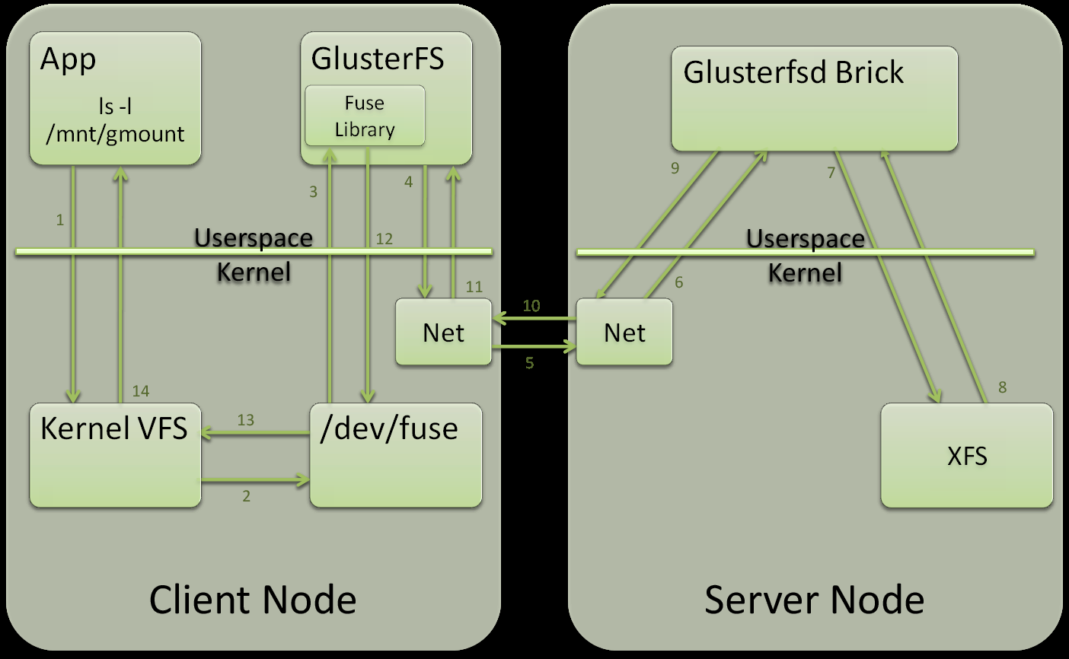
Fuse

Slide 28
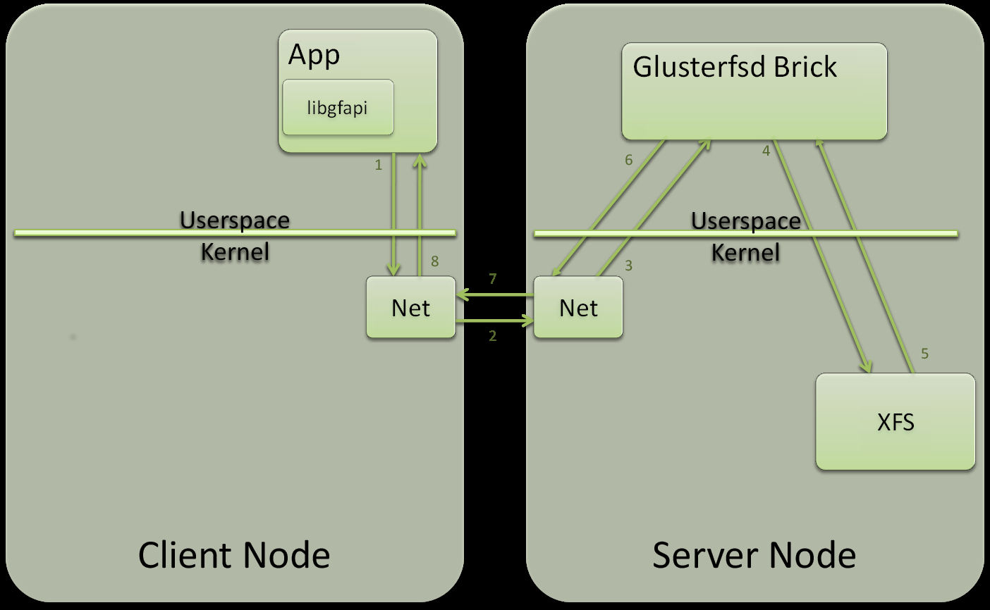
libgfapi

Slide 29
New block driver in QEMU to support VM images on gluster volumes – Uses libgfapi to do IO on gluster volumes directly
Python version:
git clone https://review.gluster.org/libgfapi-python
from gluster import gfapi
import os
volume = gfapi.Volume(....)
volume.mount()

Slide 30
Fuse Native
FUSE kernel module allows the filesystem to be built and operated entirely in userspace
Specify mount to any GlusterFS server
Native Client fetches volfile from mount server, then communicates directly with all nodes to access data
Use any node from the trusted pool
Recommended for high concurrency and high write performance
# mount -t glusterfs host1:/dist-vol /mnt/glusterfs

Slide 31
Demo
Volume Types

Slide 32
Create gluster server
GlusterFS Server Packages
glusterfs
glusterfs-server
glusterfs-api
glusterfs-cli
Glusterfs-libs
GlusterFS Client Packages
glusterfs
glusterfs-client-xlators
glusterfs-libs
glusterfs-fuse

Slide 33
Create gluster server
1.prepare 2 vms
On both vms:
1)mkfs.xfs -i size=512 /dev/sdb1
mkdir -p /data/brick1
echo '/dev/sdb1 /data/brick1 xfs defaults 1 2' >> /etc/fstab
mount -a && mount
2.install glusterfs-server on both vms
Get from brew: brew download-build --arch=x86_64 --latestfrom=rhgs-3.1-rhel-7-candidate glusterfs
Steps:
wget http://download.gluster.org/pub/gluster/glusterfs/LATEST/EPEL.repo/glusterfs-epel.repo
wget ftp://195.220.108.108/linux/epel/7/x86_64/u/userspace-rcu-0.7.9-1.el7.x86_64.rpm
rpm -ivh userspace-rcu*
yum install -y glusterfs-server
Start the gluster:
Systemctl enable glusterd
Systemctl start glusterd

Slide 34
Create gluster server
3. Configure trusted pool:
in vm1:
gluster peer probe vm2
In vm2:
gluster peer probe vm1
4.create the volume
On both vms:
mkdir /data/brick1/gv0
in one of the vm:
gluster volume create gv0 replica 2 server1:/data/brick1/gv0 server2:/data/brick1/gv0
Start the volume:
gluster volume start gv0
5.check the info:
gluster volume info
The glusterfs can be used now,can have a try!

Slide 35
Gluster use in qemu
Support vmdk/vdi/vpc/raw/qcow2 formats
For example:
qemu-img create -f vmdk/vdi/vpc/raw/qcow2 gluster://hostname/volume_name/filename [size]
Create snapshot:
qemu-img create -f qcow2 -b /home/kvm_autotest_root/images/win8-32.1-virtio-scsi.qcow2 gluster://10.66.8.112/gv0/sn1.qcow2
Install or boot guest with gluster backends
For example:
-drive file=gluster://$host/$volume/$image.qcow2
Migration using gluster backends
Hotplug/unplug gluster backends

Slide 36
References
http://oss.sgi.com/LDP/HOWTO/Kernel-HOWTO/create_initrd.html
http://www.linfo.org/vmlinuz.html
https://technet.microsoft.com/en-us/library/cc732280(v=ws.10).aspx
http://www.gluster.org/community/documentation/index.php/Libgfapi_with_qemu_libvirt
http://blog.gluster.org/2014/09/glusterfs-and-nfs-ganesha-integration/
http://fuse.sourceforge.net/
https://gluster.readthedocs.org/en/latest/Quick-Start-Guide/Architecture/
A

